Slide 1
Open-Source Intelligence (OSINT) & Techniques
Ryan Boulrice

Slide 2
Introduction to OSINT
OSINT refers to intelligence collected from publicly available sources.
Used in cybersecurity, law enforcement, journalism, and threat intelligence.
Helps identify risks, analyze threats, and gather information on individuals or organizations.

Slide 3
Why OSINT is Important
Supports cybersecurity investigations and penetration testing.
Helps organizations assess their online exposure and security posture.
Used in fraud detection, criminal investigations, and corporate security.

Slide 4
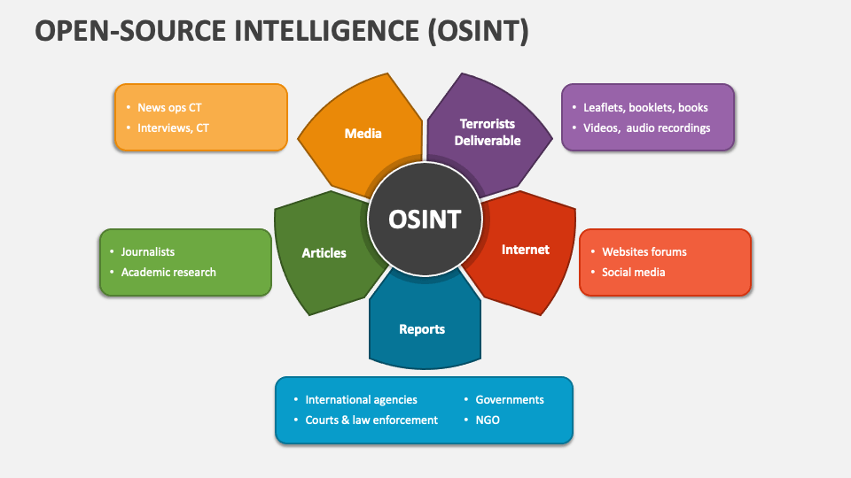
OSINT Data Sources
Search Engines: Google, Bing, DuckDuckGo
Social Media: Twitter, LinkedIn, Facebook, Instagram
Public Databases: WHOIS, Shodan, Have I Been Pwned
Dark Web: Onion sites, leaked credential repositories
Government Records: Court documents, patents, SEC filings

Slide 5
OSINT Techniques
Google Dorking
Social Media Intelligence (SOCMINT)
Website & Domain Reconnaissance
Metadata Analysis
Network Scanning (Shodan, Censys)
Dark Web Intelligence

Slide 6
Google Dorking – Introduction
Advanced search queries to find hidden or indexed data.
Used to locate sensitive information, exposed credentials, and misconfigured systems.
Helps cybersecurity professionals and ethical hackers identify security gaps.

Slide 7
Google Dorking – Common Queries
Site Search: site:example.com (Finds indexed pages of a website)
Filetype Search: filetype:pdf confidential (Finds PDFs with "confidential")
Login Pages: inurl:admin login (Finds admin login portals)
Exposed Credentials: intitle:"index of" passwords.txt (Finds directories with password files)
Camera Feeds: inurl:view/view.shtml (Finds publicly exposed cameras)

Slide 8
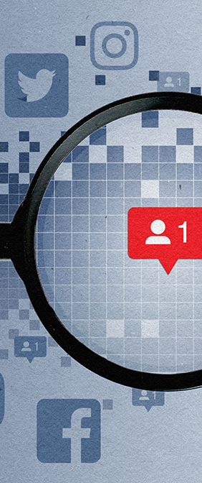
Social Media Intelligence (SOCMINT)
Collects information from platforms like LinkedIn, Twitter, and Facebook.
Analyzes user profiles, posts, location data, and interactions.
Tools: Maltego, Sherlock, OSINT Framework.

Slide 9
Website & Domain Reconnaissance
Gathers information about a domain and its infrastructure.
WHOIS Lookups: Identifies domain registrants and contact details.
Subdomain Enumeration: Finds hidden or forgotten subdomains.
Technologies Used: Detects CMS, hosting provider, and backend technologies.
Tools: Whois, Sublist3r, BuiltWith.

Slide 10

Network Scanning – Shodan & Censys
Identifies open ports, misconfigured devices, and IoT exposures.
Shodan: Search engine for internet-connected devices.
Censys: Scans global infrastructure for vulnerabilities.
Used to find exposed databases, webcams, and industrial systems.

Slide 11
Ethical & Legal Considerations
OSINT should comply with laws and ethical guidelines.
Avoid hacking, unauthorized access, and privacy violations.
Be mindful of data protection regulations (GDPR, CCPA).
Always obtain consent where required.

Slide 12
Conclusion
OSINT is a powerful method for gathering intelligence legally.
Always use OSINT ethically and responsibly.
Stay updated on evolving techniques and tools.

Slide 13
References
Enzoic. (February 27, 2025). A Comprehensive Look at OSINT. Security Boulevard. https://securityboulevard.com/2025/02/a-comprehensive-look-at-osint/
Google Dorking: How a Simple Google Search Can Expose Your Sensitive Data. (June 5, 2024). Netizen Blog and News. https://blog.netizen.net/2023/08/22/google-dorking-how-a-simple-google-search-can-expose-your-sensitive-data/

